Slide 1
Fungi in Soil

Slide 2
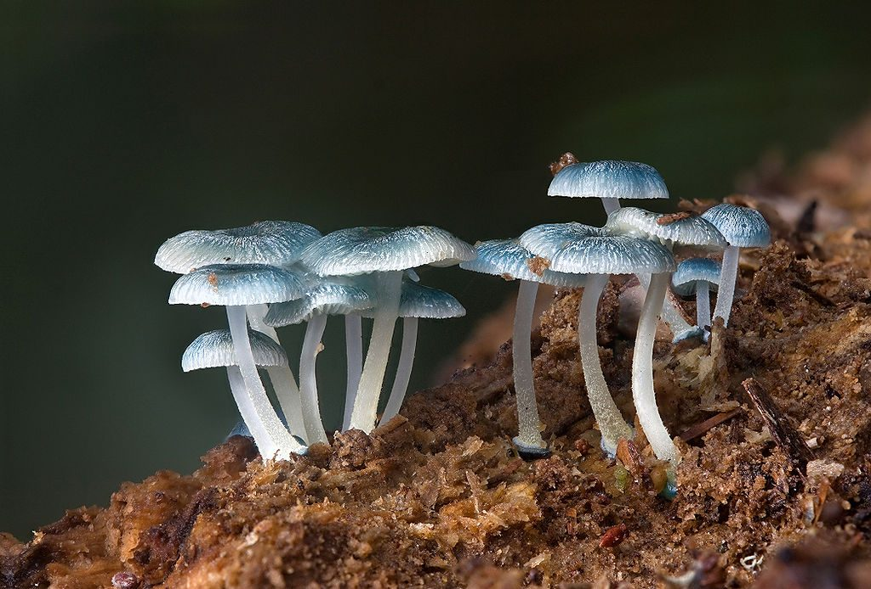
Types of fungi
Saprophytes – feed on organic matter that is difficult to break down such as crop residue
Decomposers and nutrient transporters. Store nitrogen in hyphal bodies and release nitrogen by decomposing.
Parasites – attach foliar and root plant material, other fungi, nematodes, and micro and macroarthropods
Mutualists – trade nutrients with plants

Slide 3
Microorganisms - fungi
Habitat characteristics
Aerobic only
Tolerant of acidic soil
Moderately dry
Forest, compost, garden/field, or prairie
Role in food chain and ecosystem
Decomposers – consume lignin and soil humic acids, and others
Occasionally nitrogen fixation

Slide 4
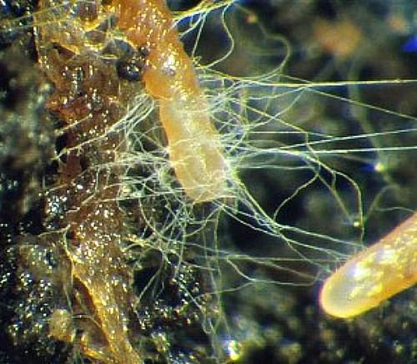
Symbiosis
Plants and fungi are symbiotic – because of this, fallow fields lose their fungi (no plants to interact with)
80-95% of land plants benefit from a mycorrhizal fungus
Fungi inserts hyphae into the plant root for exchange of nutrients

Slide 5
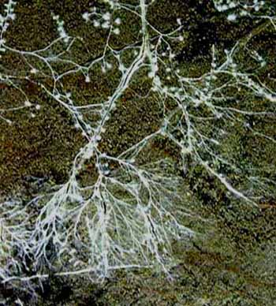
Symbiotic Relationships – Plant, Fungus, Bacterium
Bacteria live on or near the hyphae.
Fungus takes carbon from the plant and gives carbon to phosphate-solubilizing bacteria.
Phosphate-solubilizing bacteria create enzymes to solubilize phosphorus.
Fungus takes up phosphorus and gives it to the plant.

Slide 6
Symbiotic Relationships – Plant, Fungus, Bacterium
Example:
Grass type plant and legume plant.
Fungus can connect the two different plants – becomes a conduit.
Bacteria lives in nodule on the legume plant. Legume plant uses the nitrogen.
Fungus can take some of the nitrogen from the plant and transfer it to the grass plant.
For bacteria to fix nitrogen (change N₂ atmospheric nitrogen to NO₃ plant-available nitrate) it is an energy intensive process. Every N₂ molecule from the atmosphere needs 32 ATP (adenosine triphosphate) needs 128 phosphorus atoms and 320 carbon atoms.
Fungus gets phosphorus from phosphate-solubilizing bacteria and transports it to the nitrogen-fixing bacteria.
Fungus also transfers phosphorus to grass.
Five organisms: two plants, two bacteria, and one fungus.

Slide 7
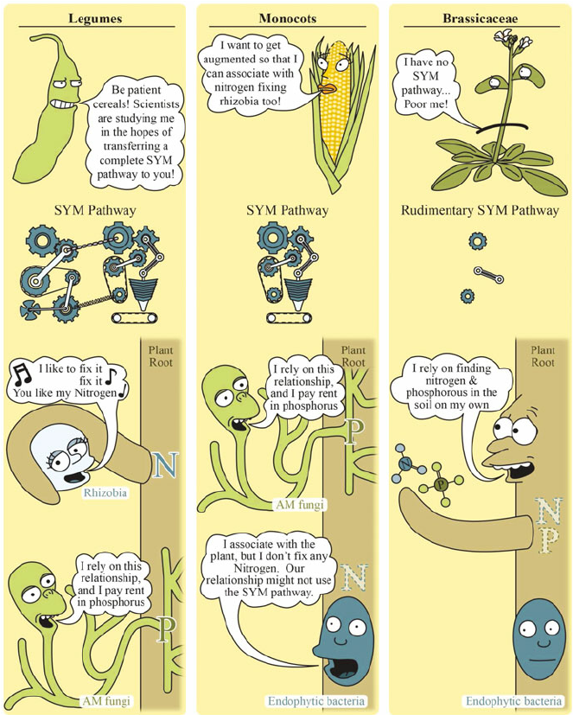
From: https://www.researchgate.net/figure/The-elaborate-symbiotic-signalling-pathway-SYM-pathway-that-is-conserved-in-legumes_fig1_277720739

Slide 8
Symbiotic Relationships – Plant, Fungus, Bacterium
Fungus has the ability to obtain and provide the plant up to 90% of the nitrogen and phosphorus needs of the plant.
The fungus requires 4-30% of the plant’s carbon.
Healthy fungal communities could help farmers reduce their need to apply fertilizer.
Fertilizer application on crops can have a negative impact on mycorrhizal fungi development because it could inhibit this natural exchange if nutrients are already readily available.
Any N or P that the plant can’t get from this symbiotic relationship has to be added in a plant-available form like fertilizer.

Slide 9
Fungi – Building Soil Structure
Fungal hyphae create a net that holds soil particles and soil aggregates together.
Think of it as a hair net in the soil.
Aggregations is largely a biological process
Arbuscular mycorrhizal fungi connect plant roots to minerals in the soil.
The arbuscules help transport the minerals into the plant.
Fungi produce a biomolecule – a protein called glomalin – making a waxy seal on the surface of the soil aggregate.
This waxy coating minimizes the water’s ability to break apart the soil aggregate.

Slide 10
Fungi – Building Soil Structure
Source: https://blancharddemofarms.org/research/role-of-arbuscular-mycorrhizal-soil-fungus

Slide 11
Fungi in the soil - review
Fungi can prey on nematodes
Some fungi can cause disease in plants
Fungi can work symbiotically with plants
Fungi can bind soil particles

